Slide 1


Cyber Security Activities
Notes:
THE IMITATION GAME - Official UK Trailer - Starring Benedict Cumberbatch
https://www.youtube.com/watch?v=j2jRs4EAvWM

Slide 2

Outline of the Activities - Activity 1: Crack the Code - Activity 2: Guess the Hash - Activity 3: Steganography - Activity 4: Magic QR Code - Activity 5: Spot the Fake Website

Slide 3

Activity 1: Crack the Code
In this activity, you will:
Understanding how the Caesar Cipher works.
Using a Python script to encrypt and decrypt messages.
Modifying the script to brute-force decrypt a message by testing all possible shifts.
Uncovering a hidden URL or secret word to complete the challenge.
Notes:
https://studio.code.org/s/hoc-encryption/lessons/1/levels/1
Caesar Cipher Wheel

Slide 4
Crack the Code
Access the GitHub repository and wait for the lecturer to go through the scripts.
Part 1:
Use Replit for Python scripting (https://replit.com/)
Run “EncryptionExample” script to see how encryption works with a known shift.
Modify the shift value to test other possibilities manually.
Part 2:
Can you modify the script to decrypt an encrypted message?
Try to decrypt a message by brute-forcing all possible shifts (0–25).
Hint: Update the script to loop through all shifts.
Notes:
Time: about 20 minutes

Slide 5
Extension Task:
Add input functionality so the script can encrypt/decrypt custom messages.
Example:
text = input("Enter your message: ")
shift = int(input("Enter the shift value: "))
print("Encrypted message:", caesar_cipher(text, shift))
Discuss why Caesar Cipher is insecure (e.g., brute-forcing is too easy).
Notes:
Time: about 10 minutes

Slide 6
Reflection and Discussion
Questions to Discuss:
How does encryption protect information?
Why is the Caesar Cipher no longer secure?
What modern encryption methods are used today?
Key Points:
Encryption is essential for data security.
Simpler ciphers are vulnerable to brute force, emphasizing the need for strong algorithms like AES.
Notes:
Time: about 10 minutes
Note to staff:
Monitor progress and help students modify the script if they’re stuck.
Emphasize experimentation—encourage students to try different inputs and shifts.
Use the activity to introduce the concept of "frequency analysis" if time permits (how often letters like E or T appear in English).

Slide 7
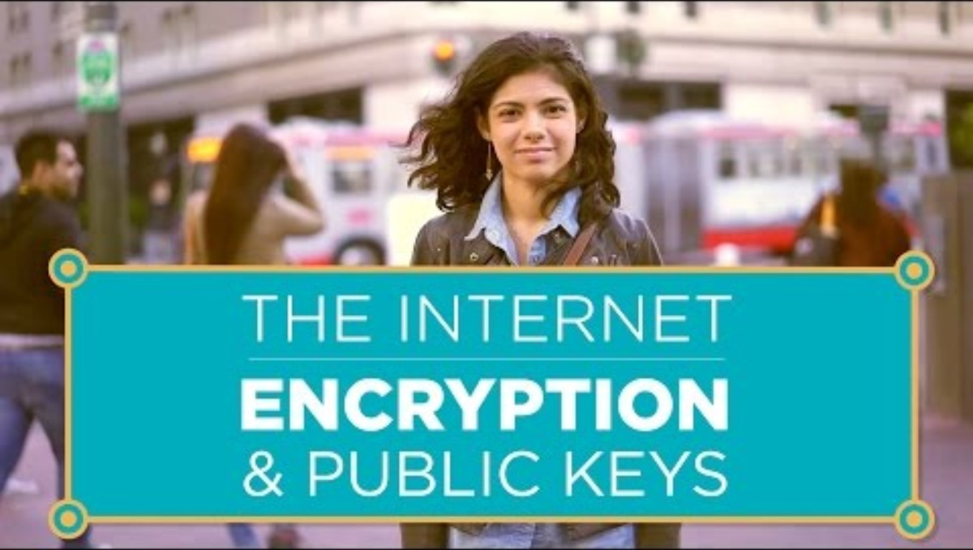
Introduction
Cipher
Encryption
Decryption
Caesar’s Cipher
Algorithm
Asymmetric Encryption
Notes:
You can play the video at the end if needed.
https://youtu.be/ZghMPWGXexs?si=IVcGACRN74FnbgfS
The Lava Lamps That Help Keep The Internet Secure
https://www.youtube.com/watch?v=1cUUfMeOijg

Slide 8
Activity: Spot the Fake Website
In this activity, you will:
How to spot fake websites by analysing key elements.
Why phishing sites are created and how they deceive users.
How to protect yourself online.
Notes:
https://studio.code.org/s/hoc-encryption/lessons/1/levels/1
Caesar Cipher Wheel

Slide 9

Activity: Spot the Fake Website
Notes:
Vevox - Dashboard

Slide 10
Activity: Magic QR Code
In this activity, you will:
Interact with QR codes that perform unexpected actions (e.g., opening URLs, sending emails).
Learn how attackers use QR codes for phishing or malware distribution.
Discuss how to verify the safety of QR codes before scanning.

Slide 11
Magic QR Code
Scan the QR codes and note what happens.
Some codes will open safe websites.
Others will display unexpected messages or pre-written emails.
Watch out for fake phishing message(s) or a malicious QR code.

Slide 12
Extension Task:
Create your own QR Code
Verification Tools
Check the link first
Norton Snap
Kaspersky QR Scanner
Notes:
Time: about 10 minutes

Slide 13
Reflection and Discussion
Questions to Discuss
What makes QR codes risky?
How can attackers use QR codes for phishing or malware distribution?
What steps can you take to ensure QR codes are safe before scanning?
Key Takeaways
Always verify QR codes before scanning, especially in public spaces.
Avoid scanning QR codes that look suspicious or come from untrusted sources.
Use mobile security software that warns against malicious links.
Notes:
Time: about 10 minutes

Slide 14
Activity: Guess the Hash
Understanding how hashing works.
Writing a Python script that hashes user inputs.
Guessing the original word from a provided hash by trying possible inputs.
Reflecting on the importance of hashing in password security.
Notes:
About 20-30 minutes
Hashing Basics:
Hashing creates a fixed-length representation of data.
Hashes are irreversible (you cannot "decode" a hash).
Common algorithms: MD5 (weak), SHA256 (stronger).

Slide 15
Guess the Hash
Part 1:
Hashing and its applications (e.g., storing passwords securely)
Hashing is one-way: you can’t reverse it, but attackers can guess inputs to find matches (brute force).
Part 2:
Can you move the target word out of the main python file?
If you managed to read the word from another file, you could play a short game in pairs. One sets the target word
While the other player should aim to guess the word.
Give some hints or limited number of trails to guess the word.
Notes:
Staff Notes
Be ready to help students debug issues like incorrect indentation or input errors.
Emphasize ethical considerations—students should never try to brute-force real passwords.
Share a few “fun” hashes for them to guess (e.g., hash of "chocolate" or "cybersecurity").

Slide 16
Extension Task:
Ask students to modify the script:
Replace hashlib.md5 with hashlib.sha256.
Generate their own hash (e.g., hash "password123") and challenge classmates to guess it.
Discuss how longer hashes (e.g., SHA256) increase security compared to shorter ones (e.g., MD5).
Notes:
Time: about 10 minutes

Slide 17
Reflection and Discussion
Questions to Discuss:
Why can’t we reverse a hash?
Why are weak hashes (e.g., MD5) insecure for modern applications?
How does this activity demonstrate the importance of strong passwords?
Key Points:
Hashing is crucial for secure password storage.
Weak passwords can be brute-forced by guessing inputs.
Longer and more complex passwords are harder to guess.
Notes:
Time: about 10 minutes

Slide 18
Activity: Steganography
In this activity, you will:
Learn how to hide (encode) and extract (decode) messages in images using Python.
Explore how attackers use steganography to hide data in plain sight, including in social media images.
Gain hands-on experience using a steganography library and Use Python to encode and decode secret messages

Slide 19
Steganography
Review and understand the script provided.
Replicate it in your own Replit session and choose a hidden message.
Run the script “StegEncode” for encoding the message into the image.
Download and open the generated image. Run the script “StegDecode” for decoding the message from the image.
Notes:
Students may need to install the stegano library.

Slide 20
Extension Task:
Add input prompts for the image file, message, and output file names.
Discuss limitations of steganography (e.g., detectable by advanced analysis).
Compare steganography with encryption.
Notes:
Time: about 10 minutes

Slide 21
Reflection and Discussion
Questions to Discuss:
How can steganography be used for good and bad purposes?
Why is it important to be aware of such techniques in cyber security?
How can we detect steganography in forensic investigations?
Key Takeaways:
Steganography hides data but doesn’t encrypt it—adding encryption can increase security.
Be cautious with images or files received from unknown sources.
Notes:
Time: about 10 minutes

Slide 22

Any question?
Please participate in a quick survey
bit.ly/csltueventsurvey
(5 min)

Slide 23
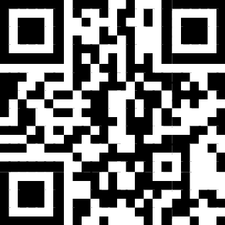
GITHUB CODE
Activity 4: Python code for phishing
Alternatively, you can scan the QR-code
Notes:
Navigate to this link: https://tinyurl.com/2zzpmksn

Slide 24


REPLIT Registration https://replit.com/

Slide 25

The Lava Lamps for Cyber Security
Random numbers
Passwords
Encryption key
Notes:
https://youtu.be/ZghMPWGXexs?si=IVcGACRN74FnbgfS
The Lava Lamps That Help Keep The Internet Secure
https://www.youtube.com/watch?v=1cUUfMeOijg

